Slide 1
Management of currency & Currency Chest Mechanism
Sanjeev Gupta
Manager
Issue Department, New Delhi

Slide 2
Meaning Importance and legal Provisions
Introduction
Currency Management is one of the traditional central banking functions. It was the main reason for establishing RBI.
(As per Section 3 of RBI Act)

Slide 3
What is Management?
Planning
Organising
Controlling

Slide 4
What is Currency?
Notes
Coins

Slide 5
What is the Meaning of Currency Management?
Legal Framework
Infrastructure
Estimate - How?
Indent
Issue
Withdraw
Destroy
Reserve Management
Design
R&D
Technology
Customer Service
Counterfeiting
Public Awareness
Coordination

Slide 6
Legal Provisions
Currency
Notes
  Currency Note (1 Re Note) issued under Currency Ordinance 1940 – treated as Rupee Coin
  Bank Note (Rs. 2 and above)
Coins (Indian Coinage Act, 1906)
  Rupee coins (≥ Re. 1)
  Small coins (< Re. 1) – only 50p.

Slide 7
Legal tender of coins
Less than Rupee 1………………Rs.10/-
Rupee 1 and above………………Rs.1000/-
Government of India has
  Sole right to mint coins
  Responsibility on coinage
  Designing and minting of coins

Slide 8
India Government Mints - 4
Mumbai
Alipore (Kolkata)
Saifabad (Hyderabad)
NOIDA (UP)
PREAMBLE TO RBI ACT
TO REGULATE THE ISSUE OF BANK NOTES and
THE KEEPING OF RESERVES WITH A VIEW TO SECURING MONETARY STABILITY IN INDIA and
GENERALLY TO OPERATE THE CURRENCY & CREDIT SYSTEM OF THE COUNTRY TO ITS ADVANTAGE

Slide 9
CURRENCY MANAGEMENT
Issue of notes/ coins
Making available note and coins of required denomination
Ensure quality of notes in circulation
Settlement of claims against defective, mutilated etc. Notes
Maintenance of reserve for note issue

Slide 10
NOTE ISSUE
SECTION 17 (Business which the Bank may transact)
Sub - Section (15)
  BANK SHALL MAKE AND ISSUE BANK NOTES
  SUBJECT TO PROVISIONS OF THE ACT
{FIRST ISSUE OF BANK NOTES IN
JANUARY 1938- RS 5, RS 10}

Slide 11
SECTION 22
SUB SECTION 1:
  BANK SHALL HAVE THE SOLE RIGHT TO ISSUE BANK NOTES IN INDIA

Slide 12
SECTION 23
SUB-SECTION 1
  ORGANISATIONAL SET UP OF ISSUE DEPARTMENT
    SHALL BE SEPARATE
    DISTINCT FROM BANKING DEPT..
    ASSETS OF ID NOT TO BE SUBJECTED TO ANY LIABILITIES OTHER THAN THE LIABILITIES OF ID

Slide 13
SECTION 23
SUB-SECTION 2
  ISSUE OF NOTES TO BKG DEPTT OR TO ANY OTHER PERSON ONLY IN EXCHANGE FOR
  OTHER BANK NOTES
  COIN BULLION, SECURITIES AS PERMITTED BY THE ACT TO FORM A PART OF THE RESERVE

Slide 14
SECTION 24
SUB-SECTION 1
  DENOMINATION OF BANK NOTES (2, 5, 10, 20,50,100, 500, 1000, 5000, & 10000)
  OR SUCH OTHER DENOMINATION AS THE CG ON RECOMMENDATION OF CB MAY SPECIFY
  CONTD…..

Slide 15
SECTION 24
SUB-SECTION 2
  CENTRAL GOVT. ON RECOMMENDATION OF THE CENTRAL BOARD MAY DIRECT
  NON-ISSUE OR
  DISCONTINUANCE OF ISSUE OF
  BANK NOTE OF ANY DENOMINATIONAL VALUE

Slide 16
SECTION 25
DESIGN
FORM
MATERIAL OF BANK NOTES
APPROVED BY CENTRAL GOVT AFTER CONSIDERATION OF THE RECOMMENDATION OF CENTRAL BOARD

Slide 17
SECTION 26
SUB - SECTION 1
  Every Bank Note Is Legal Tender At Any Place In India & Shall Be Guaranteed By CG Subject To The Prov. Of Sub-section 2
SUB-SECTION 2
  ANY SERIES
  ANY DENOMINATION
  CEASES TO BE LEGAL TENDER
  FROM SUCH DATE SPECIFIED
  IN THE GAZETTE
BY CENTRAL GOVERNMENT ON RECOMMENDATION OF THE CENTRAL BOARD

Slide 18
SECTION 27
BANK SHALL NOT REISSUE
  TORN
  DEFACED
  EXCESSIVELY SOILED NOTE

Slide 19
SECTION 28
NO PERSON SHALL HAVE THE RIGHT TO
RECOVER FROM CG / BANK VALUE OF ANY
  LOST
  STOLEN
  MUTILATED OR
  IMPERFECT CURRENCY / BANK NOTES

Slide 20
SECTION 28
BANK MAY WITH PREVIOUS SANCTION OF CG PRESCRIBE
  CIRCUMSTANCES IN &
  CONDITIONS SUBJECT TO WHICH
  VALUE OF SUCH NOTE IS REFUNDED AS A MATTER OF GRACE

Slide 21
SECTION 29
BANK NOT LIABLE TO PAY STAMP DUTY ON BANK NOTES
UNDER INDIAN STAMP ACT 1899

Slide 22
BALANCE SHEET AS ON 30TH JUNE 2012
ISSUE DEPARTMENT RUPEES IN THOUSAND
LIABILITIES NOTES HELD IN BD 89,169 NOTES IN CIRCULATION 11034,645,327 TOTAL NOTES ISSUED 11034,734,496 | ASSETS GOLD COIN & BULLION HELD IN INDIA 760,096,797 HELD OUTSIDE INDIA ------ FOREIGN SECURITIES 10261,966,851 RUPEE COINS 2,206,548 RUPEE SECURITIES 1046,43,00 PROMISSORY NOTES & ---------------- BILLS OF EXCHANGE
TOTAL 11034,734,496 | 11034,734,496

Slide 23
Section 33(1) – ASSETS OF I.D.
Gold coin,
Gold bullion,
Foreign securities,
Rupee coin
Rupee securities
Certain eligible bills*
* In practice such bills have not figured as assets of ID. However NABARD p/n under sec17(4e) of RBI Act may be held as an asset.

Slide 24
Section 33(2)
The total of gold and foreign securities held should not be less than Rs. 200 crores
Gold value being not less than Rs. 115 crores

Slide 25
Section 33(3)
The balance of the assets will be in the form of rupees coin, GoI rupee securities of any maturity and eligible bills of exchange

Slide 26
Section 33(4)
The valuation of assets
1) gold is valued at the end of the month at 90% of the daily avg price quoted at London for the month (w.e.f.1st Oct1990)
2)Re equivalent is determined on the basis of exc rate prevailing on the last business day of the month
Gains / losses are adjusted to CGRA
Rupee coin at face value

Slide 27
Section 33(5)
Of the gold coin & gold bullion held as assets, not less than 17/20th shall be held in India, in the custody of the bank or its agencies
Provided that gold belonging to the bank which is in any other bank or any / treasury mint or in transit be reckoned as part of the assets

Slide 28
FOREIGN SECURITIES :----- Sec. 33(6)
FOREIGN SECURITIES CONSISTS OF :---
BALANCES WITH OVERSEAS CENTRAL BANKS
BALANCES WITH IMF, IBRD, IDA, IFC, ADB, BIS, ETC.
SECURITIES ISSUED BY IMF, IBRD, IDA, IFC, ADB, BIS ETC.
FOREIGN GOVT. SECURITIES MATURING WITHIN 10 YEARS.
CONTD……….

Slide 29
FOREIGN SECURITIES ---- VALUATION
FOREIGN SECURITIES:----
AT MARKET PRICE
APPERICIATION IGNORED
DEPRECIATION PROVIDED

Slide 30
RUPEE COIN :----
RUPEE COIN CONSISTS OF :---
ONE RUPEE NOTES
RUPEE COINS –1, 2, 5, 10
SPECIAL ISSUE OF COINS IN HIGHER
DENOMINATIONS
NOTE:---- SMALL COINS ( 50 PAISE & BELOW) ARE NOT RUPEE COIN & HENCE NOT ASSET

Slide 31
RUPEE SECURITIES
RUPEE SECURITIES CONSISTS OF :-----
GOVT. SECURITIES OF ANY MATURITY
SPECIAL SECURITIES (oil bonds, Food Corporation of India bonds, fertiliser bonds, power bonds, etc ) & TREASURY BILLS
PRIOR TO 1997 – AD HOC TREASURY BILLS

Slide 32
RUPEE SECURITIES
VALUATION
AT LOWER OF BOOK VALUE OR MARKET VALUE
APPRECIATION NOT ACCOUNTED FOR
DEPRECIATION ADJUSTED AGAINST CURRENT INCOME

Slide 33
Currency account (for notes other than one rupee notes) | Notes Stock account (General stock of notes other than those held under the other heads mentioned below)
 | Exchange Notes account (box balance)
 | Chest Notes account (chest balances)
 | Circulation Notes account (Notes in circulation)
 | Invoiced Notes account (notes received from chests and other offices and awaiting disposal)
 | Guarantee Notes account (notes tendered by banks and others and held pending examination at a later date)
 | Reissuable Notes account (Reissuable notes held in stock)
 | Retired Notes account (Examined notes collected after examination/processing and held in the retired notes vault before being written off under warrant cum destruction certificate)

Slide 34
SECTION 34
LIABILITY OF ISSUE DEPARTMENT
  TOTAL AMOUNT OF CURRENCY NOTES OF GOVT.
  TOTAL AMOUNT OF BANK NOTES IN CIRCULATION

Slide 35
SECTION 38
OBLIGATION OF GOVT. & THE BANK TO SUPPLY DIFFERENT FORMS OF CURRENCY
  CG SHALL NOT UNDERTAKE TO PUT INTO CIRCULATION ANY RUPEES EXCEPT THROUGH THE BANK
  BANK SHALL UNDER TAKE NOT TO DISPOSE OF RUPEE COIN OTHERWISE THAN FOR THE PURPOSE OF CIRCULATION

Slide 36
SECTION 39(1)
OBLIGATION TO SUPPLY DIFFERENT FORMS OF CURRENCY
BANK SHALL ISSUE RUPEE COINS ON DEMAND
  IN EXCHANGE OF BANK NOTES/ CURRENCY NOTES
SHALL ISSUE CURRENCY NOTES IN EXCHANGE FOR
  COINS WHICH ARE LEGAL TENDERS

Slide 37
SECTION 39(2)
BANK SHALL IN EXCHANGE FOR
  CURRENCY NOTES
  BANK NOTES
SUPPLY
  BANK NOTES
  CURRENCY NOTES OF LOWER DENOMINATION OR OTHER COINS WHICH ARE LEGAL TENDER
QUANTITIES -DECIDED BY THE BANK -REQUIRED FOR THE PURPOSE OF CIRCULATION

Slide 38
SECTION 39(2)
CENTRAL GOVT SHALL SUPPLY SUCH COINS TO THE BANK ON DEMAND
IN CASE OF FAILURE ON THE PART OF CG TO SUPPLY- BANK IS RELEASED FROM THE OBLIGATION

Slide 39
Section 53
The bank is required to prepare and transmit a weekly statement of account of the issue department (also banking deptt) in the prescribed form to GoI.
It also required to prepare and transmit annual accounts of the bank within 2 months from the date of annual closing.

Slide 40
Section 58(2) (q)
The bank will have power to make regulations with the approval of the GoI for payment of value in respect of lost, stolen, mutilated or imperfect bank notes.
Note refund rules have been framed under this provision read with Section 28.

Slide 41
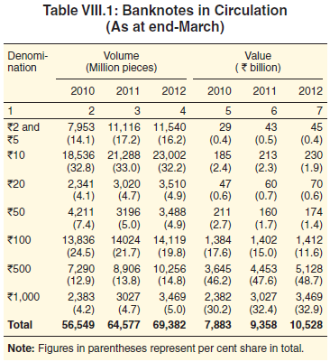

Slide 42
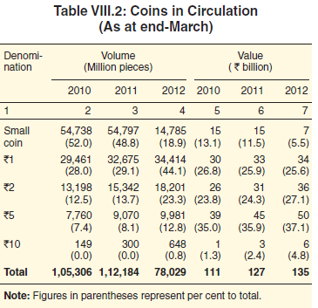

Slide 43
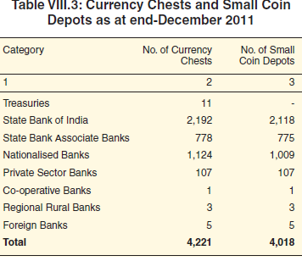

Slide 44
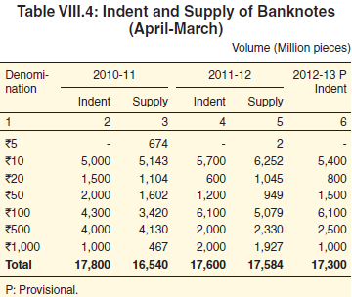

Slide 45
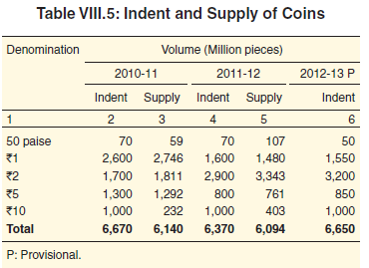

Slide 46
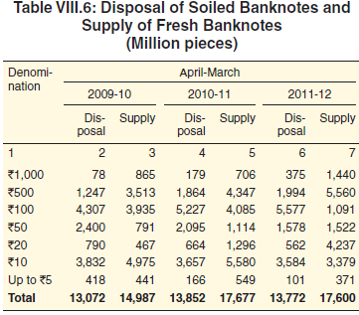

Slide 47
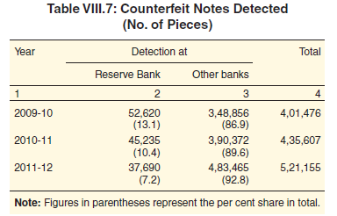

Slide 48
Clean Note Policy
स्वच्छ नोट निति

Slide 49
RBI Act, 1934 - Section 27
The Bank shall not reissue bank notes which are torn, defaced or excessively soiled.
Announced by RBI Governor in 1999.
Ensure "adequate, good quality clean notes are available throughout the country".

Slide 50
Clean Note Policy – Two Aspects
Supply
Withdrawal

Slide 51
Steps to implement Clean Note Policy
Modernisation of existing banknote printing presses and the mints
BRBNMPL set up on February 03, 1995. Two banknote printing presses commenced production from June 01, 1996 and December 11, 1996, respectively.

Slide 52
Steps to implement Clean Note Policy
Mechanisation – CVPS, SBS, CVM, NSM
Stop Stapling of notes – Directive – November 2001
Coinisation
Polymer Notes
Special Drives
ICCOMS
Incentive and Penalty
CPCs

Slide 53
Public Awareness
  Not to staple the banknotes
  Not to write / put rubber stamp or any other mark on the banknotes
  Store the banknotes safely to prevent any damage

Slide 54
CURRENCY CHEST MECHANISM
Sec.39 (2) of RBI Act, 1934
RBI shall in exchange for notes of two rupees or upwards, supply notes of lower value or other coins which are legal tender in such quantities as may be required for circulation.
So, the responsibility for proper and efficient distribution of notes within the circle rests with the Issue Department of the circle.

Slide 55
CURRENCY CHESTS
Nothing but strong rooms where stocks of fresh,reissuable, soiled notes and rupee coins are stored.
•The currency chests are extensions of issue department and may be regarded as receptacles.
•Mini-issue departments

Slide 56
OPERATIONS IN Cy.CHESTS
Deposit of bank notes - reduction in notes in circulation
Withdrawal of bank notes- increase in notes in circulation
Deposit of rupee coin-Increase in Assets of Issue Dept
Withdrawal of rupee coin- reduction in Assets of Issue Department

Slide 57
CURRENCY CHEST MECHANISM
Currency chests are nothing but strong rooms at the appointed branches of the banks.
In these strong rooms, stocks of fresh, reissuables and also soiled bank notes are stored. In other words, the currency chests are extensions of Issue Office.
The bank notes and Rupee coins held in currency chest are, therefore, the property of Issue Department.

Slide 58
CURRENCY CHEST MECHANISM
Purposes for opening the currency chests:
1. To meet the currency requirements of the public
2. To maintain the quality of currency in circulation by withdrawing unfit notes
3. To afford exchange facilities of one denomination into another.
4.To meet the payments of Governments/banks/public.
Contd.

Slide 59
CURRENCY CHEST MECHANISM Purposes for opening the currency chests:
5. To operate remittance facilities conveniently
6. To arrange for exchange of mutilated and other notes as per Note Refund Rules
7. To obviate the necessity of physical transfer of cash from one place to another at frequent intervals and
8. To enable the banks to work with minimum cash balance of their own.

Slide 60
CURRENCY CHEST MECHANISM
How it works?
The bank notes printed at Nashik, Dewas, and the BRBNMPL presses at Mysore and Salboni are first sent to the Issue Departments at headquarters of 19 Issue Circles.
Then from each Issue Department, they are remitted to individual currency chests.
From the Issue Departments and Currency chests, the notes are issued to public and the total notes issued thus to public are the liabilities of Issue Department.

Slide 61
CURRENCY CHEST MECHANISM
The notes and coins are put into circulation through:
20 Issue Offices of RBI(including One sub-office at Lucknow and one currency chest of RBI at Kochi)
4221 currency chests
4018 SCDs

Slide 62
CURRENCY CHEST MECHANISM
In terms of Section 33 of RBI Act, Rupee coin stocked in Issue Department and currency chests are one of the eligible assets that can be held as backing for note issue, since Rupee coins are issued by Government of India.
So long as Rupee coins are held in Issue Department (including currency chests) they form a part of the eligible assets. The moment they are issued to public, the assets of the Issue Department get depleted.
As Rupee coins are issued on behalf of Government of India, the liability of Issue Department does not go up as in the case of their issue to public.

Slide 63
CURRENCY CHEST MECHANISM
Currency Transfers
In currency chests, every day, the bank notes and Rupee coins are deposited and withdrawn. It is called Currency Transfers, which has the capacity of altering the Assets and Liabilities of Issue Department.
Every deposit of bank notes into currency chest will reduce the liability of Issue Department. On the other hand, every withdrawal will push up its liability.
Every deposit of Rupee coins will increase the assets of Issue Department and the withdrawals will reduce its assets.

Slide 64
CURRENCY CHEST MECHANISM
The minimum amount of currency transfer in bank notes are Rs. 1,00,000 and in multiples of Rs. 50,000.
Besides, there may be Remittances between Currency chests on account of diversion orders issued by Issue Office or Fresh notes Remittances arranged from Issue Offices and remittances of soiled notes from Currency chests to Issue Office. These remittances within the Circle do not alter the Chest Notes balances.
Remittances to and from other Issue Circles will affect the balances.

Slide 65
CURRENCY CHEST MECHANISM
Opposite transfer
As per section 23
Issue Department is to be kept distinct from the Banking Department.
The assets of Issue Department are not subject to any other liability excepting its own viz. bank notes in circulation.
On account of currency transfer transactions taking place at Chests the equilibrium of assets and liabilities of Issue Department gets affected.
In order to comply with section 33, we have to bring back to equilibrium either by adjusting our assets position or liability position.

Slide 66
CURRENCY CHEST MECHANISM
How accounting of opposite transfers is done?
The currency chest will report the currency transfer transactions through ICCOMS (Integrated Computerised Currency Operations & Management System) to their respective Link Office located in the headquarters of Issue Department.
The Link Office will consolidate the figures and submit it to the Accounts Section of Issue Department daily. However, the Link Office statement will contain the transactions of the previous day through ICCOMS.
When the banks withdraw bank notes/ Rupee coins, they have to pay equivalent amount. This is done at the headquarters of issue circle by debit to the current account of bank concerned with DAD.

Slide 67
CURRENCY CHEST MECHANISM
Accounting of Opposite Transfer:
Let us suppose that there has been a net withdrawal at currency chests of SBI branches to the extent of Rs. 25 crore. The opposite transfer for this transaction is from Banking Department to Issue Department.
In Banking Department, the current account of SBI will be debited and equivalent amount accounted as payable to Issue Department.
In case of net deposits at currency chests, the opposite transfer will be from Issue Department to Banking Department. The Current account of the bank concerned will be credited.

Slide 68
CURRENCY CHEST MECHANISM
The reporting of currency transfer transaction is required to reach the Accounts Section on the same day i.e. up to 9.00 PM by the Currency Chests and upto 11.00 PM by the Link Office.
RBI charges penal interest at the rate of Bank rate + 2% on delayed reporting/ wrong reporting/non-reporting.

Slide 69
CURRENCY CHEST MECHANISM
The Banking Department is also required to put through transactions with commercial banks, government and other institutions for payments to employees and transactions under Remittance Facilities Scheme.
During the day, there may be net payment or receipt.
If there is net payment, Banking Department will draw bank notes from Issue Department. If it has surplus cash over and above their minimum cash balance (each DAD has been assigned a minimum cash balance depending on their volume of transactions) they will transfer the surplus bank notes to Issue Department.
These cash receipts/transfers in bank notes will again affect the equilibrium of assets and liability of Issue Department and the equilibrium is brought about by adjustment of eligible assets (Rupee securities and foreign securities) at DGBA, Central office.

Slide 70
CURRENCY CHEST MECHANISM
If there is a net withdrawal from Issue Department, say by Rs 25 crore, then the liability of Issue Department will go up. Eligible rupee securities or foreign securities equivalent of Rs. 25 crore would be transferred from Banking Department to Issue Department.
On the other hand, if there is a net transfer of surplus bank notes from Banking Department to Issue Department, the above assets will be transferred from Issue Department to Banking Department.

Slide 71
CURRENCY CHEST MECHANISM
Therefore, every transfer at currency chest will have an opposite transfer at RBI as under:
The equilibrium of assets and liabilities in respect of currency transfer transactions of currency chests is brought about by adjusting liability side at the headquarters of each issue circle by opposite transfer, i.e. transfer of bank notes from Issue Department to Banking Department or vice versa.
However in respect of the withdrawal/transfer of bank notes by Banking Department in adjustment of their cash balance, the change in assets and liabilities of Issue Department is off set by adjustment of assets at Central office DGBA.

Slide 72
Small Coin Depots
Coins of 50 paise and lower denominations are known as small coins. These coins are the property of the Government of India and they are issued by Reserve Bank of India on behalf of the Government of India. Small coins are stored in Small Coin Depots which are established at Treasuries/sub-Treasuries/branches of Public Sector Banks. The small coin depots are mostly housed along with currency chests in separate bin/ cup boards but accounted separately.

Slide 73
Small Coin Depots
Since the balances held in the Small Coin Depots are the property of the Central Government, any withdrawal there from will have to be off-set by affording credit to the Government account while any deposits made thereat would result in a debit to the Government account.

Slide 74
Thank You

